Slide 1
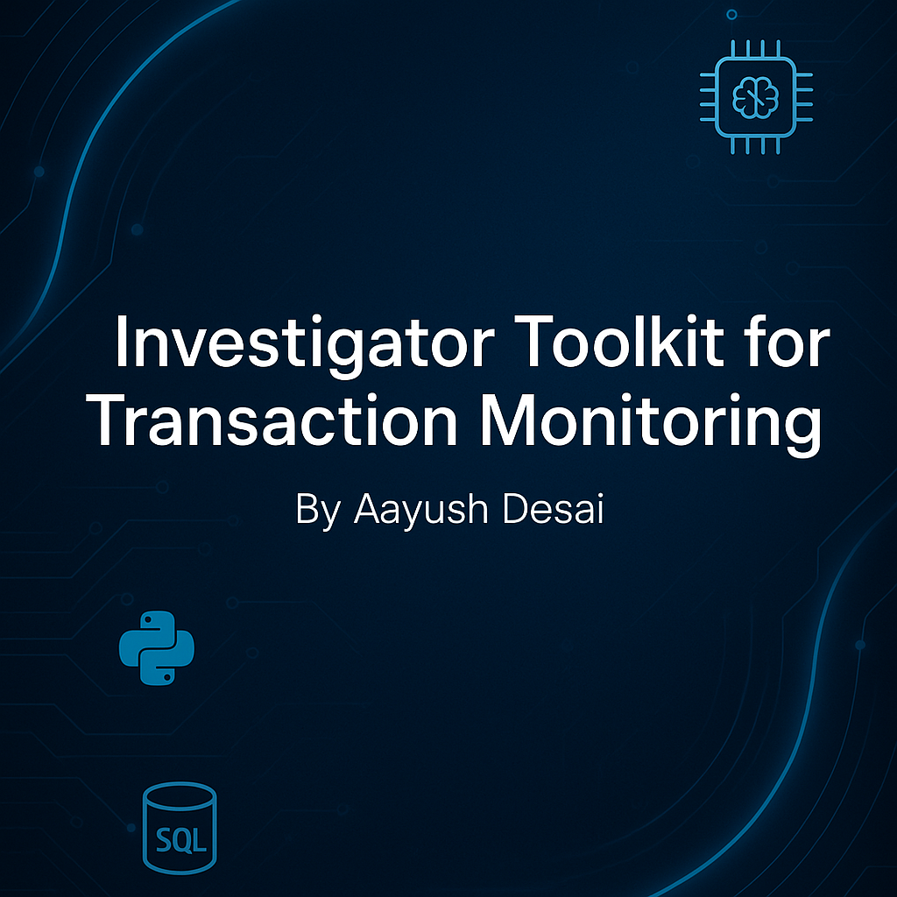
Investigator Toolkit for Transaction Monitoring
GIT REPO: https://github.com/desaiaayush78/capstone-project-repo
Aayush Desai
git repo URL

Slide 2
Problem Statement
Objective:
The primary goal of this project is to enhance transaction monitoring for financial institutions by developing a comprehensive toolkit that integrates machine learning, rule-based risk scoring, and web scraping for negative news analysis. This toolkit aims to improve fraud detection accuracy and reduce false positives, providing a more robust solution for identifying fraudulent activities.
Stakeholders
Financial institutions (banks, credit unions, insurance companies): These organizations are directly impacted by fraud and need robust systems to protect their assets and customers.
Compliance and Risk Management teams: Responsible for ensuring that the institution adheres to regulatory standards and minimizes fraud-related risks.
Data Scientists and Analysts: They will play a key role in developing and implementing machine learning models for fraud detection.
End customers: Individuals and businesses who rely on financial services and expect secure, fraud-free transactions.
Key Components:
1) Fraud Detection with Machine Learning and Rule-Based Risk Scoring
2) 3) DEPLOYMENT OF FRAUD DETECTION MODEL
3) Web Scraping for Negative News Analysis

Slide 3
Hybrid Fraud Detection System: Integrating Machine Learning and Rule-Based Risk Scoring

Slide 4
📊 Data Collection & Sources
Dataset Used: IEEE-CIS Fraud Detection Dataset
Source:Kaggle – IEEE-CIS Fraud Detection Competition
Key Features
Best for: Card transactions & online fraud detection
Size & Complexity: Large-scale dataset with labeled fraud and non-fraud transactions
Transaction Details: Includes key attributes like transaction amount, product type, card info, address, timestamp, email domain, device information, and anonymized V-features
Machine Learning Application: Ideal for building fraud detection systems using anomaly detection, rule-based systems, and risk scoring with ML models like XGBoost or Random Forest

Slide 5
📊 DATASET CONTAINS?
IEEE-CIS Fraud Detection Dataset contains 4 dataset csv file
Train_transaction.csv & test_transaction.csv
Contains transaction-related features like TransactionID, TransactionAmt, ProductCD, card details (card1 to card6), and multiple derived variables (V1 to V339).
The `train_transaction` dataset includes 590,540 records with 394 features capturing transaction-level details.
Train_identity.csv & test_identity.csv
Contains additional identity-related features, such as DeviceType, DeviceInfo, id_01 to id_38, and information about browser and system settings.
The `train_identity` dataset contains 144,233 records with 41 features providing identity-related insights.
TEST_transaction.csv
Contains transaction-related features like TransactionID, TransactionAmt, ProductCD, card details (card1 to card6), and multiple derived variables (V1 to V339).
The `test_transaction` dataset consists of 506,691 records with 393 features used for evaluating model performance.
Test_identity.csv
The test_identity dataset contains 141,907 records with 41 features that provide identity-related context for each transaction. It includes:

Slide 6
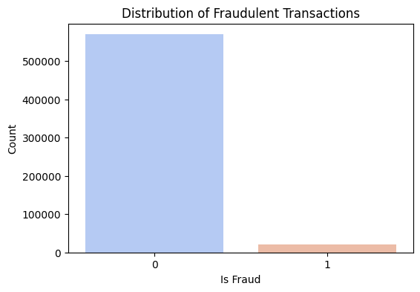
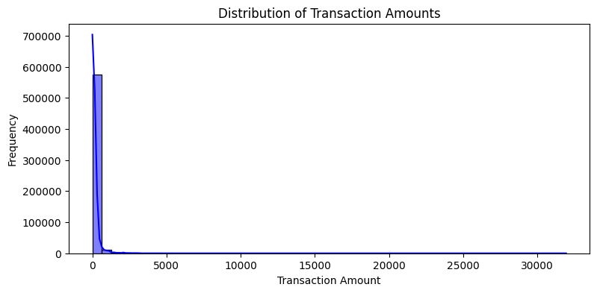
📊 Class & Transaction Insights(EDA)
Only ~3.5% of transactions are fraudulent, highlighting a significant class imbalance in the dataset.
Transaction amounts are heavily right-skewed, with most values clustered under 100 — highlighting the need for log transformation.

Slide 7
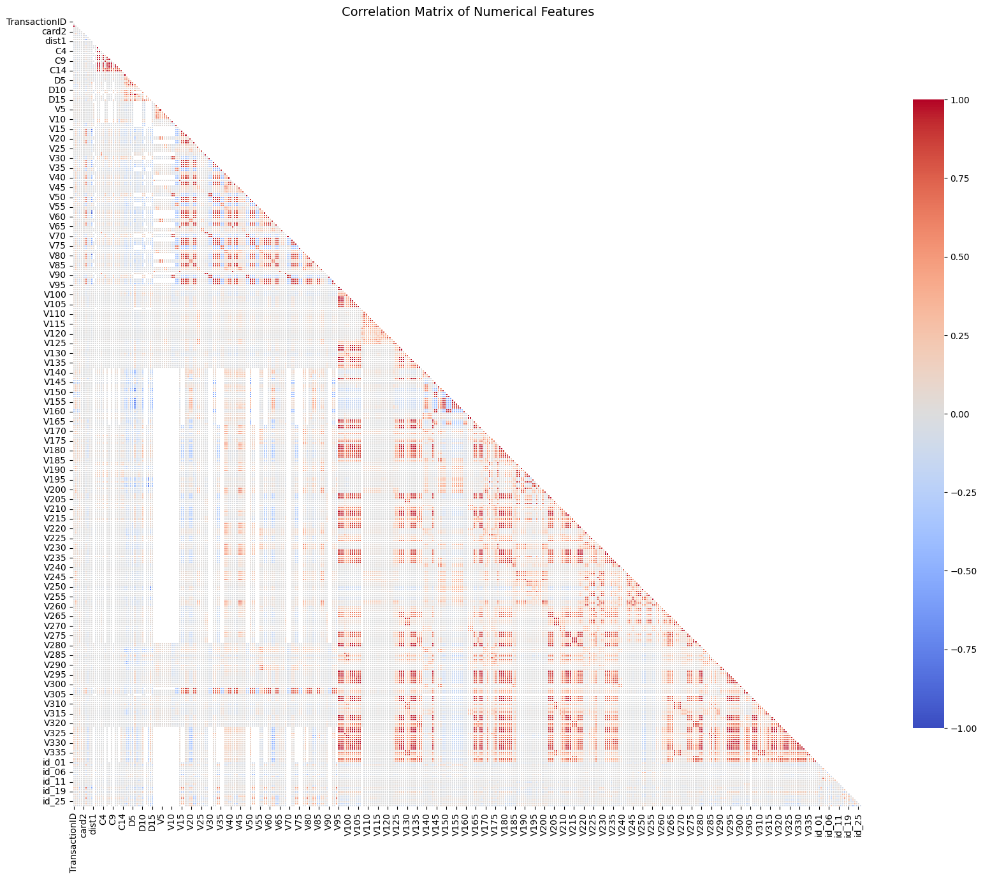
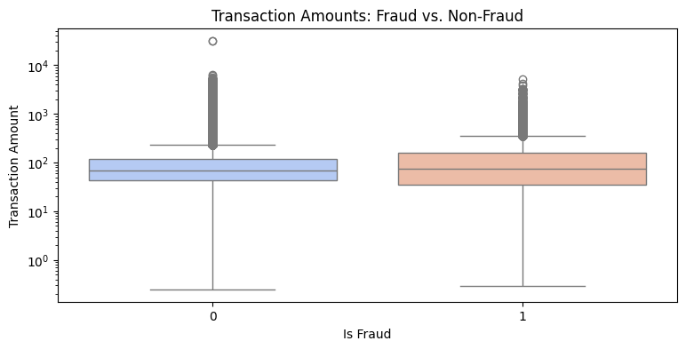
📊 Spending Patterns(EDA)
Fraudulent transactions show a higher median amount, emphasizing the value of transaction size in fraud detection.
The heatmap reveals dense blocks of correlated features, helping guide feature selection and dimensionality reduction.

Slide 8
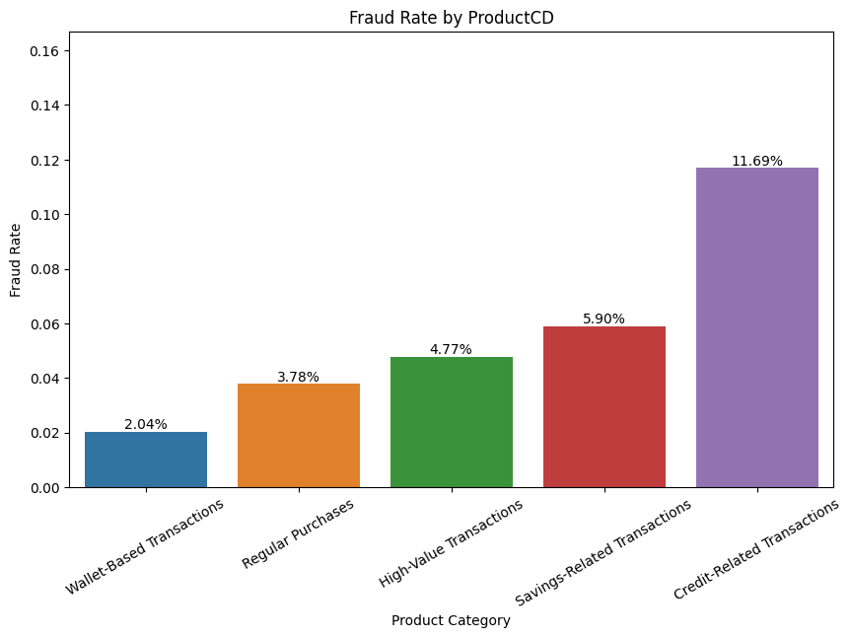
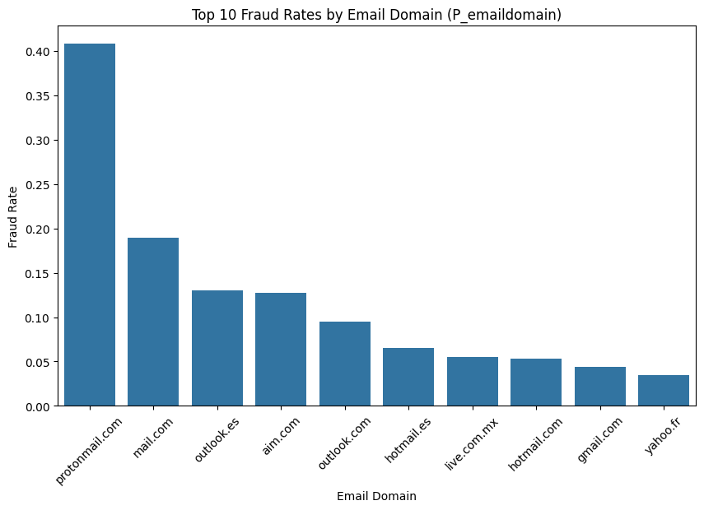
📊 Category & Time-Based Risks(EDA)
Credit-related transactions show the highest fraud rate, making product type a strong indicator of risk.
Certain domains like protonmail.com show significantly higher fraud rates, flagging them as potential risk indicators

Slide 9
📊 Data Cleaning & Preparation
Missing Values • Dropped columns with >80% missing data • Imputed remaining nulls using median strategy
Outliers • Applied log transformation on skewed fields like TransactionAmt, id_02, D15, and V258 to reduce distribution skew and stabilize variance
Format Handling • Label encoded categorical features • Standardized datetime formats for time-based features
Feature Engineering • Extracted day/hour from timestamps • Created interaction features and binned variables • Derived fraud rates by email domain & address
Feature Selection
• Removed features with low variance and high missing rates
• Selected top predictors using SelectKBest (ANOVA F-test)
• Focused on features with strong correlation to the isFraud target• Final model trained on a curated subset of ~50 high-impact features

Slide 10
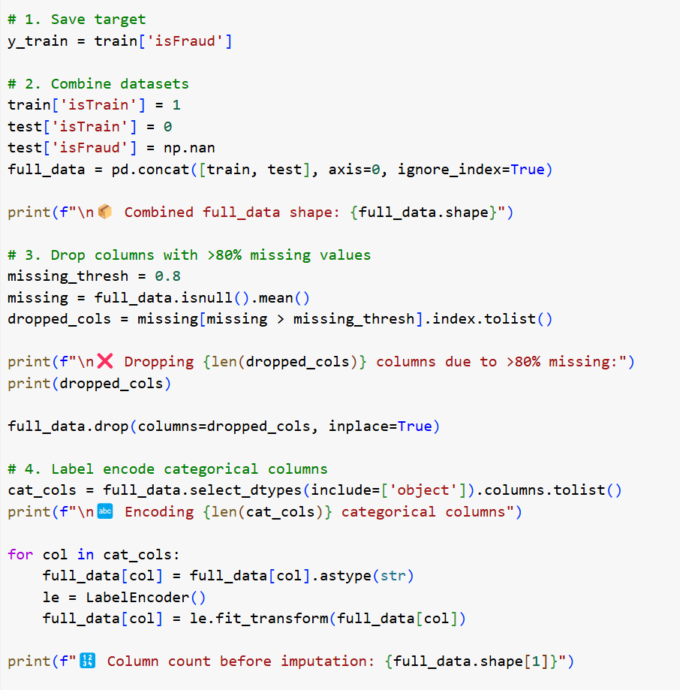
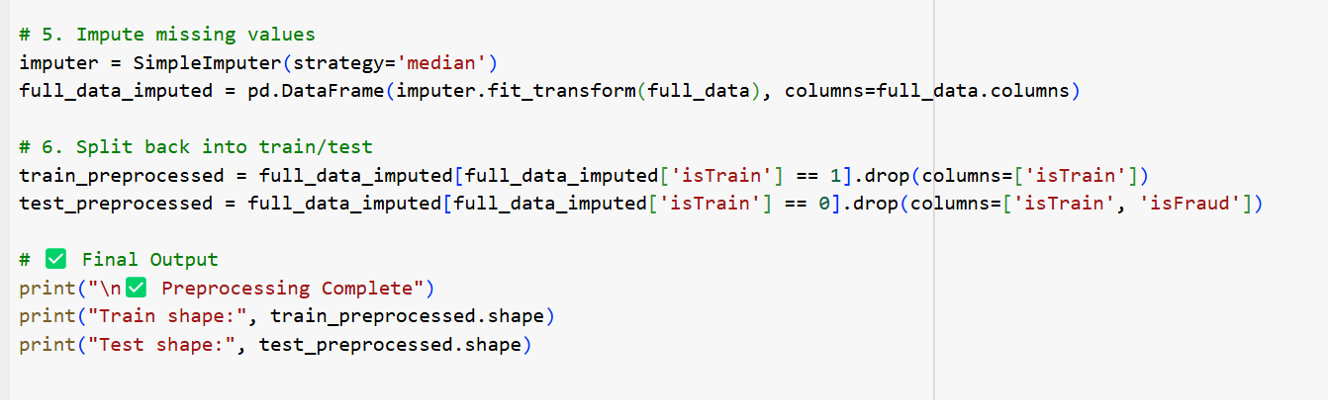
📊 Data Preprocessing
Target Saved: isFraud column extracted for supervised learning
Train-Test Combined: Merged into one dataset to apply consistent transformations
Dropped Columns: Removed features with >80% missing values
Label Encoding: Categorical columns converted to numeric using LabelEncoder
Missing Value Imputation: Filled missing values using median strategy with SimpleImputer
Split Back: Separated the processed data back into train and test sets

Slide 11
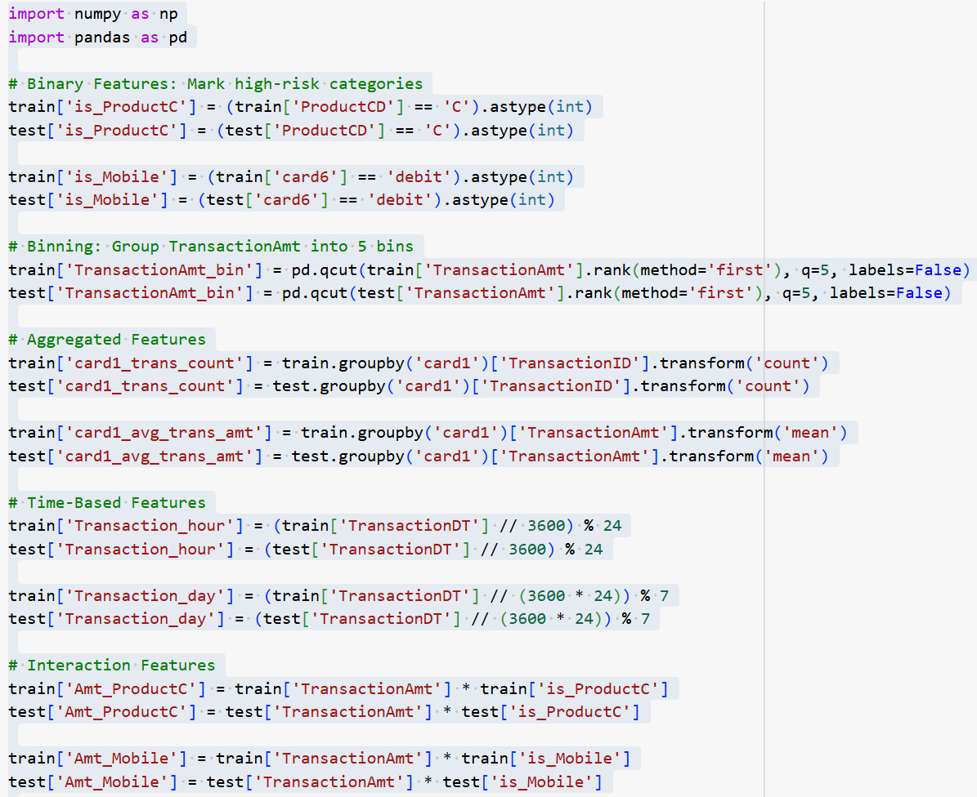
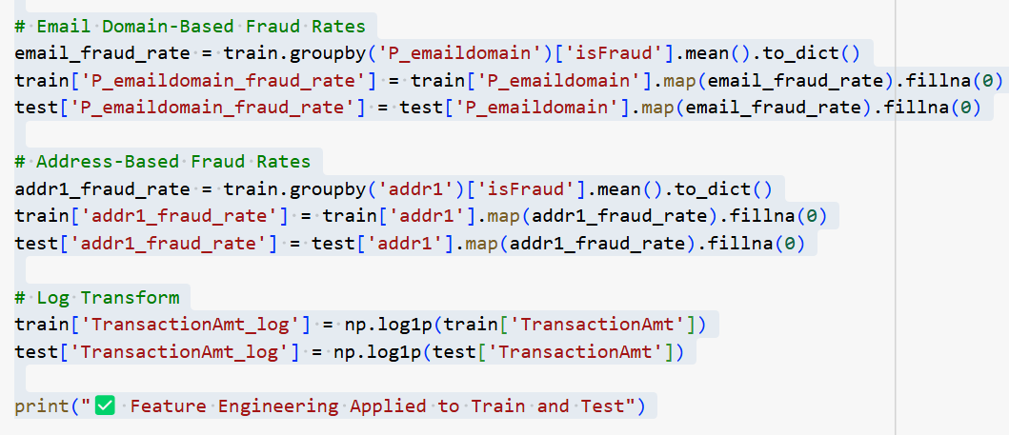
📊 Feature Engineering
Added binary flags for risky product types and card categories
Binned transaction amounts into value-based segments
Calculated transaction count and average spend per card
Extracted hour of day and day of week from timestamps
Created interaction features (e.g., amount × device/product type)
Mapped fraud rate by email domain to detect suspicious patterns
Assigned fraud risk by address region using historical rates
Applied log transformation to reduce skew in transaction amounts

Slide 12
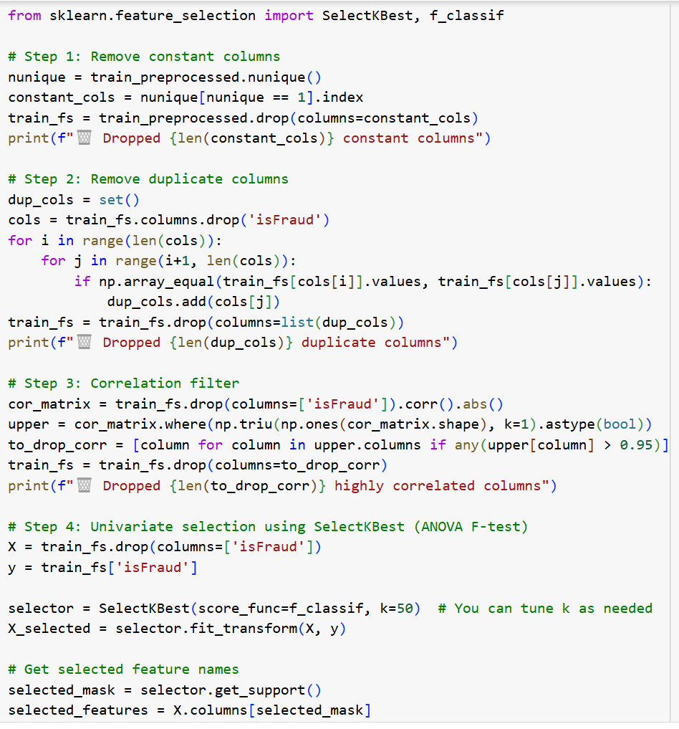
📊 Feature Selection Summary
Removed constant columns that provided no variance or predictive value
Dropped duplicate columns to eliminate redundant information
Filtered out highly correlated features (correlation > 0.95) to reduce multicollinearity and avoid model overfitting
Reapplied column filtering here (after preprocessing) to ensure we work only with cleaned, imputed data
Selected top 50 most informative features using SelectKBest (ANOVA F-test) for improved model performance

Slide 13
📊 Model Selection & Evaluation Strategy
Algorithms Used:
XGBoost Classifier: Chosen for its speed, ability to handle imbalanced data, and effectiveness in capturing complex feature interactions
Rule-Based Risk Scoring:Layered on top of ML predictions to encode domain-specific patterns (e.g., high-risk product types, unusual transaction hours)
Model Comparison & Selection: Both Random Forest and XGBoost were trained and evaluated on the same features and data splits. After comparison, XGBoost outperformed in terms of ROC-AUC and recall, especially for the minority fraud class.Thus, XGBoost was selected as the final model for its superior performance and robustness.
Why These Methods:
XGBoost handles tabular data with missing values and high cardinality efficiently
Rule-based scoring improves interpretability and captures edge-case frauds ML might miss
Evaluation Metrics:
Recall (Fraud Detection Focus): Measures ability to correctly identify frauds
Precision: Reduces false positives and protects genuine users
ROC-AUC Score: Balanced metric for overall classification quality
Confusion Matrix & F1-Score: To analyze class-level accuracy and balance tradeoffs

Slide 14
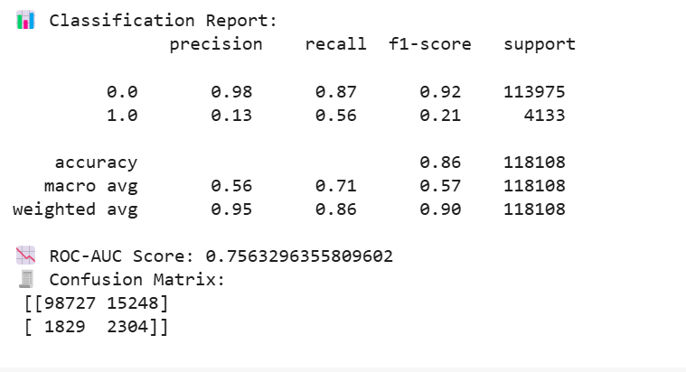
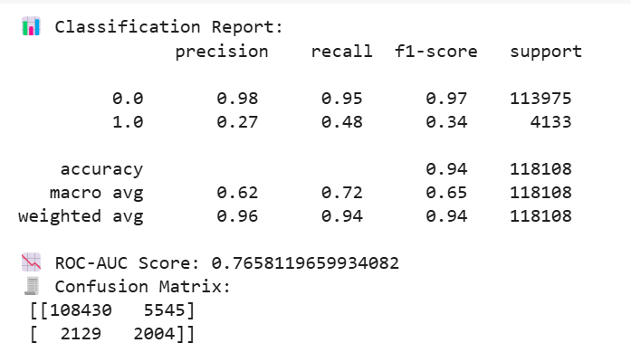
📊 ACCURACY REPORTS
Random Forest Model
XG Boost Model
The model achieves 86% accuracy and 0.76 ROC-AUC, but shows poor precision (0.13) on fraud cases, indicating high false positives despite decent fraud recall (0.56).
The model shows strong overall performance (94% accuracy, 0.77 ROC-AUC), with improved fraud precision (0.27) and a better fraud f1-score (0.34), indicating more balanced fraud detection.

Slide 15
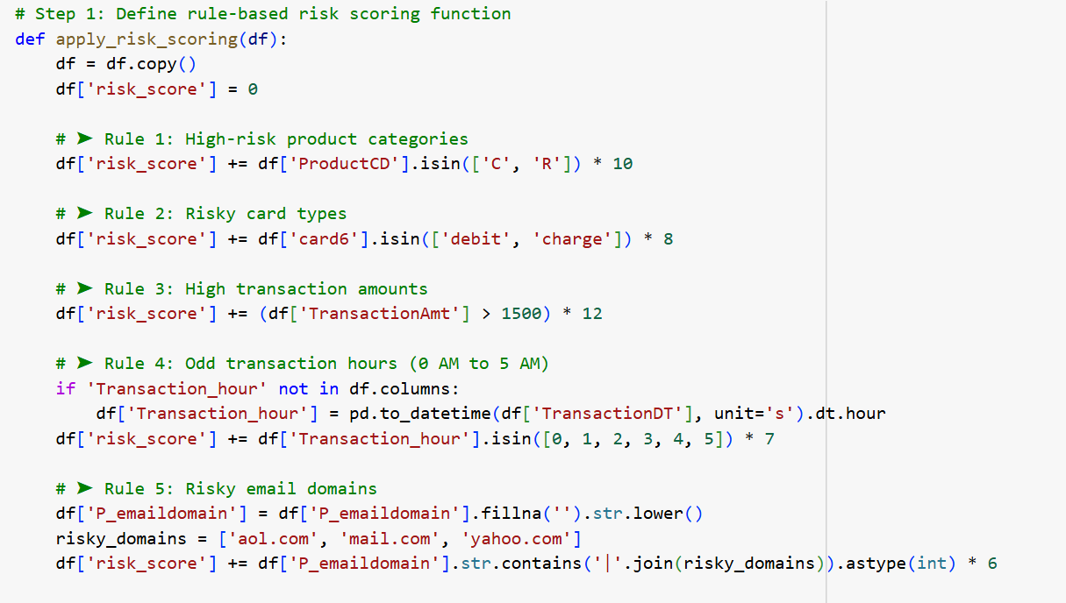
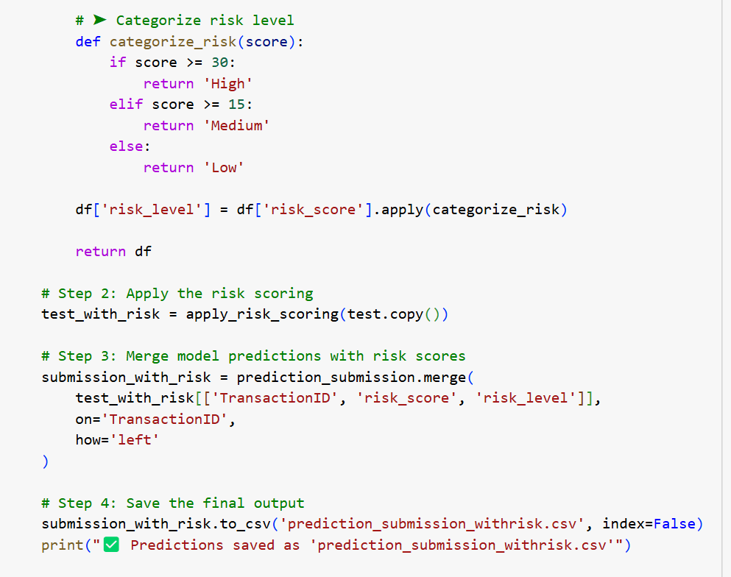
📊 Rule-Based Risk Scoring Logic
Defines a rule-based scoring system using domain knowledge
Adds risk points for:
High-risk products (ProductCD)
Risky card types (card6)
Large transaction amounts (TransactionAmt > 1500)
` Odd hours (0–5 AM via TransactionDT)
Suspicious email domains (e.g., Yahoo, AOL)
Assigns a risk level: High / Medium / Low based on score
Merges risk scores with model predictions using TransactionID
Saves final output with predictions + risk into a CSV
High Risk | Risk score ≥ 30
Medium Risk | Risk score ≥ 15 and < 30
Low Risk | Risk score < 15

Slide 16
📊 Key Findings & Model Insights
Key Findings:
XGBoost outperformed Random Forest, achieving a ROC-AUC of ~0.77 and higher recall for fraud detection.
Fraudulent transactions were strongly linked to higher amounts, certain product types, and risky email domains.
Time-based patterns showed increased fraud during early morning hours.
Interpretation of Results:
XGBoost effectively captured complex fraud patterns in high-dimensional data.
The rule-based risk scoring system complemented the model by incorporating domain logic (e.g., product category risk, transaction time) and assigning interpretable scores to each transaction.
Addressing the Original Problem:
The hybrid approach—machine learning + rule-based scoring—enhanced detection precision while reducing false positives.
It ensures accurate, scalable, and interpretable fraud detection, mirroring real-world transaction monitoring systems.

Slide 17
📊 Project Objectives & Key Questions
Project Objectives:
Develop a hybrid fraud detection system using XGBoost predictions combined with rule-based risk scoring
Implement advanced feature engineering to extract temporal, behavioral, and categorical fraud indicators
Reduce false positives by incorporating domain-specific logic (email domains, card types, transaction hours)
Key Questions Answered:
What are the top predictors of fraudulent transactions in a real-world dataset?
Can we use engineered features (e.g., transaction hour, fraud rate by domain) to improve detection accuracy?
How effective is a hybrid model combining machine learning with domain rules in detecting fraud?

Slide 18
📊 Conclusion & Recommendations
Summary of Insights:
Fraudulent transactions are rare but exhibit clear patterns in amount, time, email domains, and product types
XGBoost, enhanced with rule-based scoring, provided robust fraud detection with strong recall and interpretability
Actionable Recommendations:
Prioritize high-risk product categories and email domains for early fraud alerts
Monitor transaction behavior during off-hours, where fraud is more likely
Implement the hybrid detection system to improve fraud detection precision in real-time applications
Business Impact:
The approach reduces false positives while increasing fraud capture—leading to lower operational costs and better customer experience

Slide 19
📊 What could be improved?
Improved Precision Needed: While the model achieves high overall accuracy, it still struggles with fraud precision — meaning it's flagging many legitimate transactions as fraudulent. This indicates a class imbalance issue and room to improve false positive reduction.
With More Time/Data: I would explore feature engineering (e.g., transaction velocity, device/IP patterns), advanced resampling (SMOTE-ENN, focal loss), and hyperparameter tuning.
Next Steps: Ensemble methods (e.g., XGBoost + Rule-based logic) and real-time signal integration (e.g., geolocation, session data) could significantly boost fraud detection accuracy.

Slide 20
DEPLOYMENT OF FRAUD DETECTION MODEL

Slide 21
🚀 Model Deployment on New Dataset
Goal:To demonstrate the deployment capability of our trained XGBoost model by making predictions on an unseen test dataset using the saved pickle model.
Test Dataset :
Features preprocessed to match the structure of training data.
Only selected features used, consistent with model training.
Test data was processed using the same steps as the trained model to ensure consistency.
Deployment Workflow
Trained the fraud detection model on labeled data
Saved the trained model as a pickle file for reuse
Loaded the model to predict outcomes on new, unseen data
Generated summary reports to visualize and analyze predictions
What It Predicts:
The model outputs a binary class prediction stored in the Prediction column (0 = Not Fraud, 1 = Fraud).

Slide 22
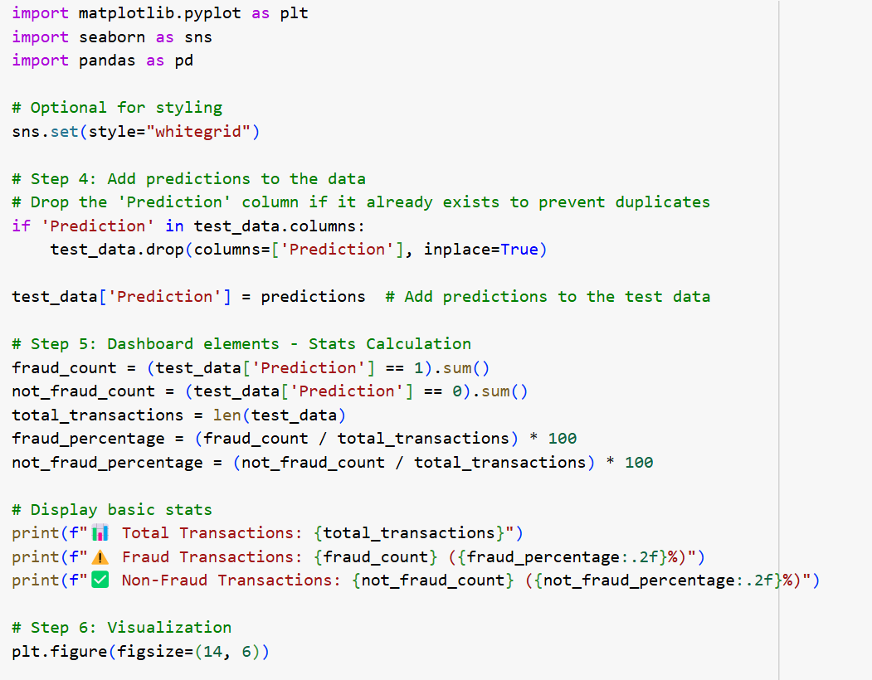
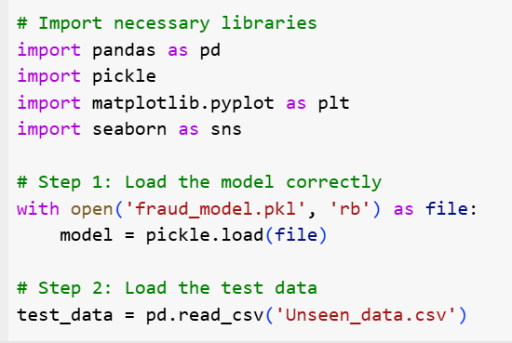
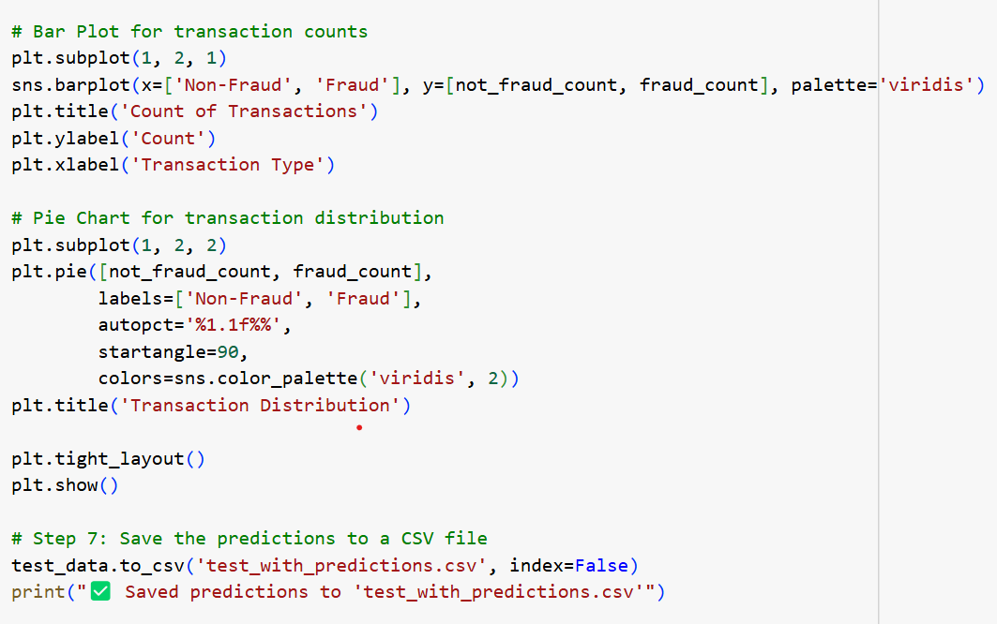
🚀 Deployment Code Snippet

Slide 23
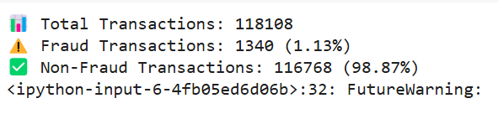
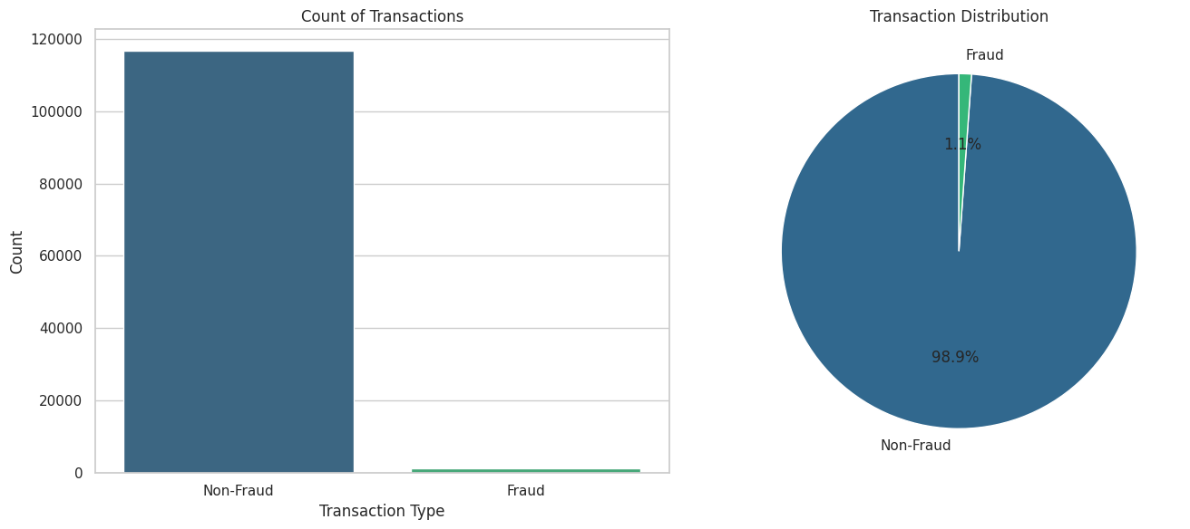
🚀 Prediction Summary: Fraud vs. Non-Fraud on New Data
The bar and pie charts show that fraudulent transactions account for 1.1% of the data, while non-fraudulent transactions make up 98.9%

Slide 24
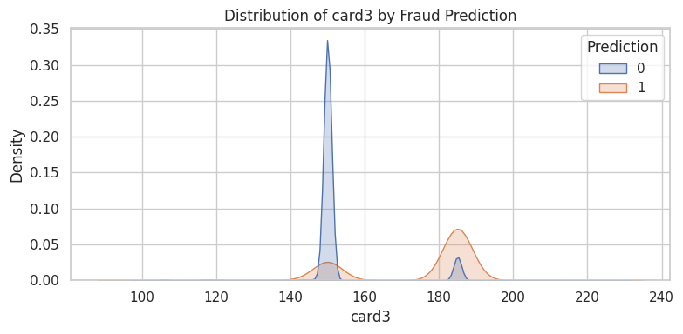
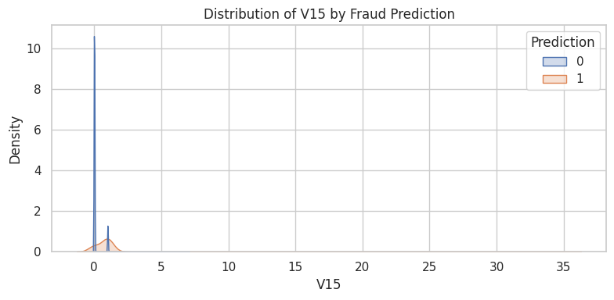
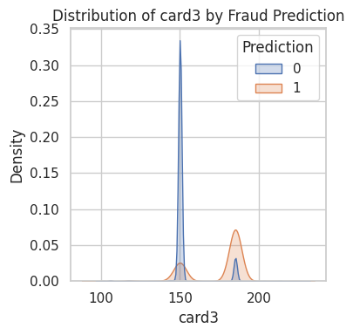
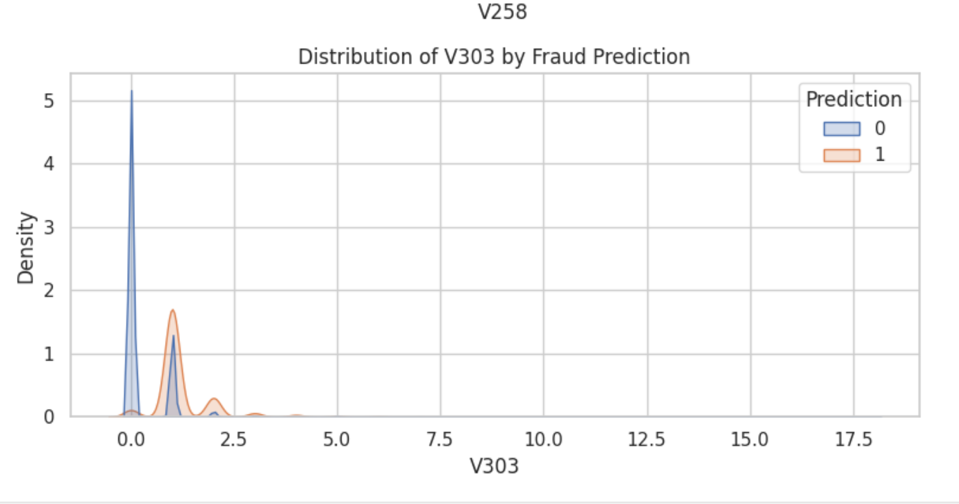
🚀 Fraud vs. Non-Fraud Distributions for Key Transaction Features
These graphs show how important features like card3, V15, V258, and V303 are distributed differently for fraud and non-fraud cases, helping us spot unusual patterns

Slide 25
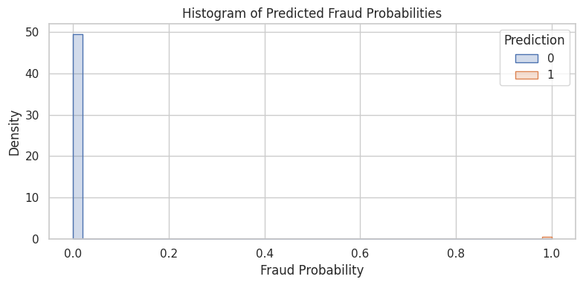
🚀 Distribution of Predicted Fraud Probabilities
The model confidently classifies most transactions as non-fraudulent, while distinctly highlighting a few with high fraud risk, showing strong separation in prediction confidence.

Slide 26
Web Scraping for Negative News Analysis

Slide 27
🌐 Adverse Media Monitoring via Web Scraping
Goal of this module is to strengthen fraud detection by checking if individuals involved in suspicious transactions have been mentioned in negative news articles online.
We do this by:
Automatically searching news sources using keywords like fraud, scam etc
Analyzes full article content to check if the individual is associated with crimes.
Assigns a score based on the presence and severity of crime-related keywords.
Classifying individuals into high, medium, or low risk based on what the media says about them
Impact & Use Case
Provides real-time adverse media insights for AML/KYC or transaction monitoring teams
Flags potentially risky individuals for further review, enhancing decision-making alongside structured model scores

Slide 28
🌐 How It Works
News Extraction: Used NewsAPI to gather recent headlines for each individual based on a curated list of financial crime keywords (e.g., fraud, money laundering, indicted).
Full Article Parsing: Employed Newspaper3k to retrieve complete article text for in-depth analysis beyond just titles or summaries.
NLP Filtering: Leveraged spaCy to verify if the individual was mentioned in sentences containing fraud-related terms.
Scoring System: Assigned a Negative News Score using weighted keywords (e.g., fraud = 3 points, indicted = 2 points).
PDF Reports: Automatically generated personalized reports detailing matched articles, keywords, scores, and action flags (e.g., Escalate, Review, Monitor).
Article Volume: Typically retrieves 5 to 20 relevant articles per person, depending on public exposure and name specificity.
Risk Classification:
Score ≥ 6 → High Risk
Score 3–5 → Medium Risk
Score < 3 → Low Risk

Slide 29
🌐 What could be improved?
Improve Relevance: Leverage NLP techniques such as Named Entity Recognition (NER) and refined keyword matching to ensure scraped articles are highly relevant to specific individuals or entities flagged in transactions.
With More Time: I would integrate multi-source scraping across trusted news sites, social media platforms, and financial forums. Coupled with sentiment analysis, this would help prioritize high-risk articles and surface hidden fraud signals.
Next Steps: Build an automated pipeline that scores and flags articles for fraud risk based on sentiment, keyword intensity, and entity overlap.

Slide 30
Project Links:
Fraud Detection
https://colab.research.google.com/drive/1anhQeqdgnOkRaU1Es6-bpK1uCRpazVWy?usp=sharing
Deployment
https://colab.research.google.com/drive/1tzQRtYatNVfKuEshtiD0OU9KOUe0Yv9n?usp=sharing
WEBSCRAPING-
https://colab.research.google.com/drive/1HDi0iyZUkodTQxv_JK07M6OFhtFcmR3Y?usp=sharing

Slide 31


